Slide 1

Building Your
Security Foundations
Basics to getting started with building
your security, governance, risk, and compliance program.

Slide 2
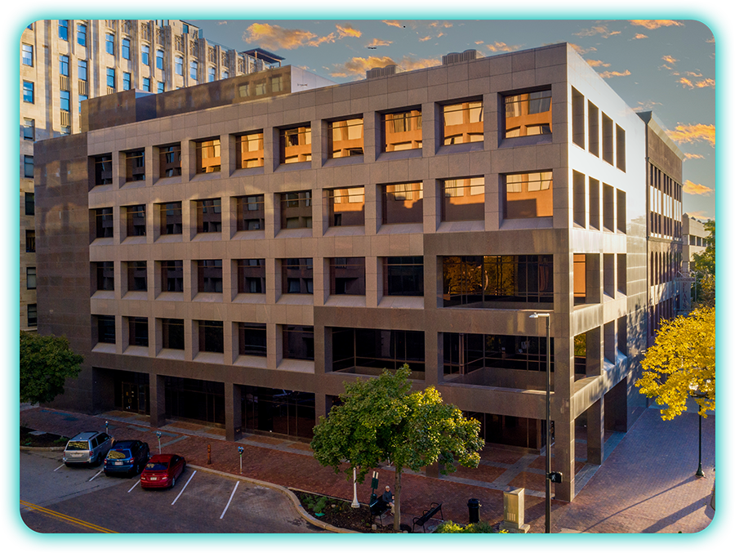
Filament Information Security
Filament Information Security is one of many nonprofit divisions under the Foundation for Educational Services (FES) in Lincoln, NE:
Federal Information Security Modernization Act (FISMA) networks, Clearwater Certifications, NIST 800-53 Compliance, audited by the Department of Education
Had to learn to achieve these things on a nonprofit budget, not a Fortune 500 one!
Began working in Ohio in 2016, began with MC OECN and ITCs.

Slide 3
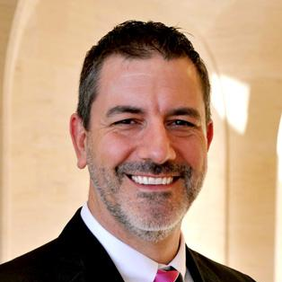
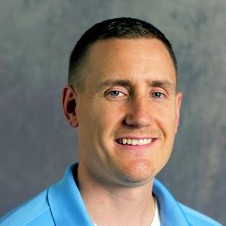
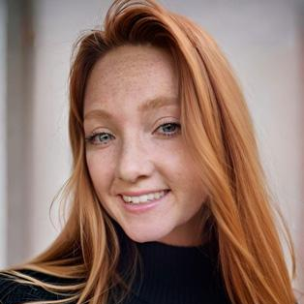
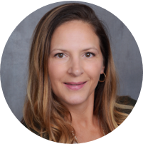

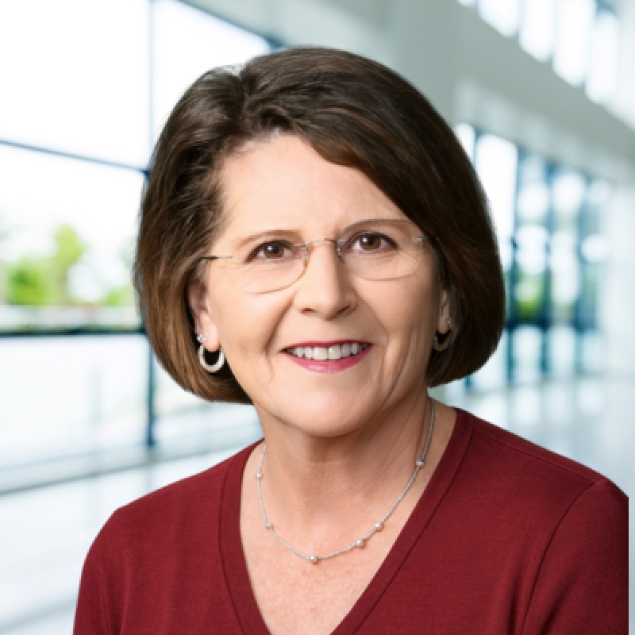


The Team
Art Provost
VP of Security Services
Tyler Malcom
Senior Security & Compliance Analyst
Keri Kunkle
Security & Compliance Analyst
Lisa Curry
Security & Compliance Analyst
Brendan Conway
Security & Compliance Solutions Manager
Dyann Bradbury
Security & Compliance Analyst
Sara Pemberton
Security & Compliance Analyst
Chandler Crist
Security & Compliance Analyst

Slide 4
What Does H.B. 96, Section 9.64(C) Say?
“The legislative authority of a political subdivision shall adopt a cybersecurity program that safeguards the political subdivision's data, information technology, and information technology resources to ensure availability, confidentiality, and integrity. The program shall be consistent with generally accepted best practices for cybersecurity, such as the national institute of standards and technology cybersecurity framework, and the center for internet security cybersecurity best practices...“
Board Resolution to adopt NIST CSF: Due June 30th

Slide 5
What is a Framework?
A security framework is a structured set of policies, controls, and best practices used to manage and reduce information security risk. It acts as a blueprint, helping organizations prioritize threats, allocate resources, and build a long-term roadmap for improvement.
How does a framework help me?
Focused on the foundational building blocks so you don’t miss anything.
Structured approach to managing reducing cybersecurity risks.
To meet state laws and pass audits.

Slide 6
Picking a Framework
Custom models are rarely accepted when legislation or regulatory standards apply. Two stand out for schools and local governments.
Supported Frameworks
NIST Cybersecurity Framework (CSF)
  Built into 6 control functions based on their goals.
  Descriptive controls, multiple ways to achieve them.
Center for Internet Security (CIS)
  Built into phases (1-3) based on maturity and budget
  Prescriptive controls, more like a task list.

Slide 7
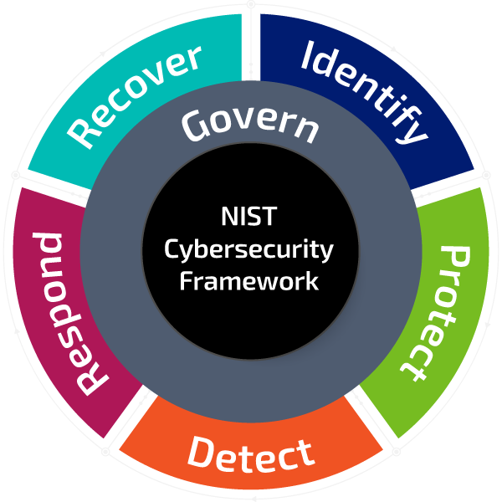
NIST Cybersecurity Framework (CSF)
Developed to improve the cybersecurity of critical infrastructure, but has since expanded to become a leading framework across multiple sectors.
Built to translate the depth of NIST 800-53 into a more accessible, flexible format for non-federal organizations.
Promotes a risk-based approach to cybersecurity planning and communication.

Slide 8
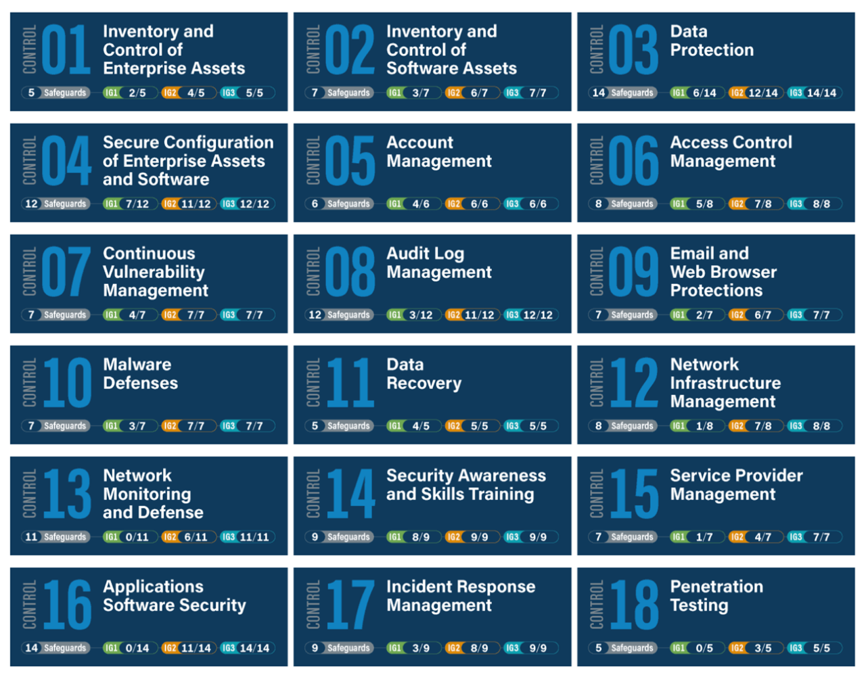
Center for Internet Security (CIS)
A nonprofit that adapted the NIST controls to make a more prescriptive and action-oriented framework.
Implementation Groups 1-3
Low Resources to High Resources.
Note that IG1 has 0 requirements for Control 13, 16, and 18, making it a lean starting point for small organizations.

Slide 9
Getting Started with Implementing a Framework

Slide 10
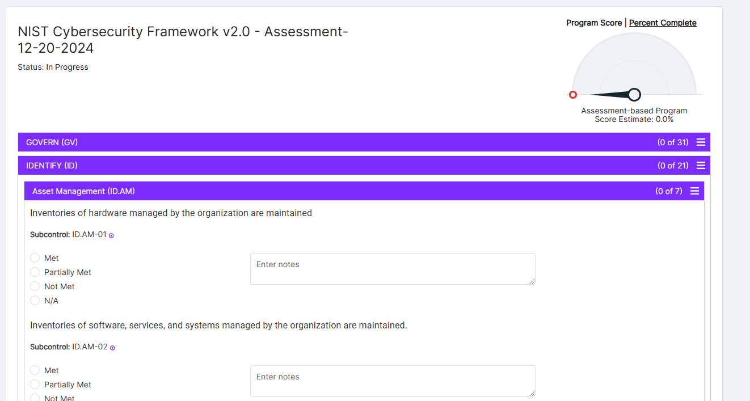
Part One: Compliance (Gap) Assessments
Engagement Expectations
Compares current practices to frameworks through a one-on-one interview process with a security analyst.
Findings Reports outline what’s missing and recommendations on how address it.
Not an audit!

Slide 11
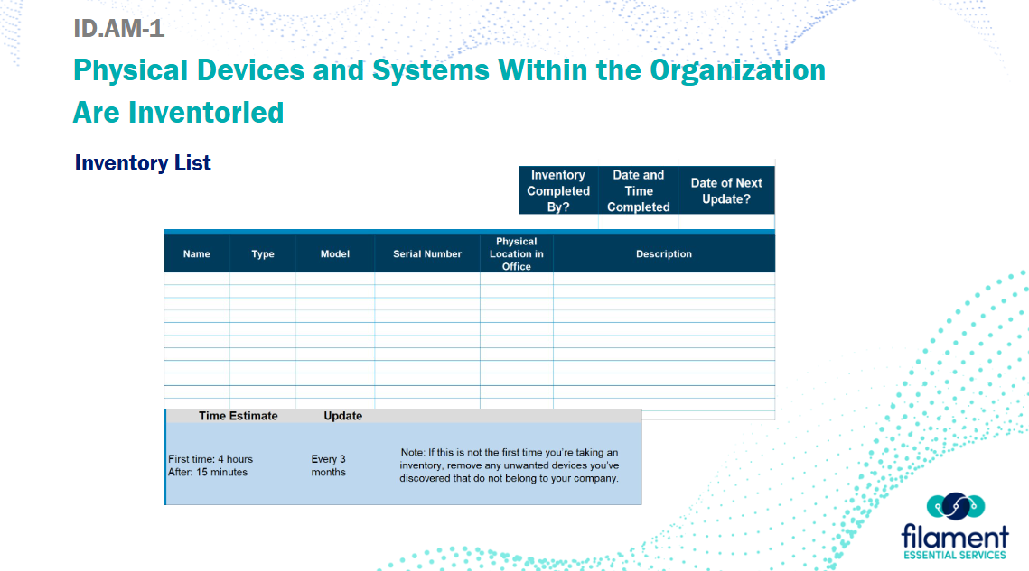
Part Two: Cohort Workshops
Engagement Expectations
Analysts review common findings from Phase 1 among the group and coach on remediation steps.
Presentations and policy templates are delivered to support you in addressing your findings.
Topics Include:
  Risk Management
  Identity, Authentication & Access Management
  Endpoint, Network & Patch Management
  Logging/SIEM
  Data Protection & Backup Integrity
  Vendor & Third Party
  Vulnerability Management & Baseline Hardening
  Email Security, Phishing & User Awareness

Slide 12
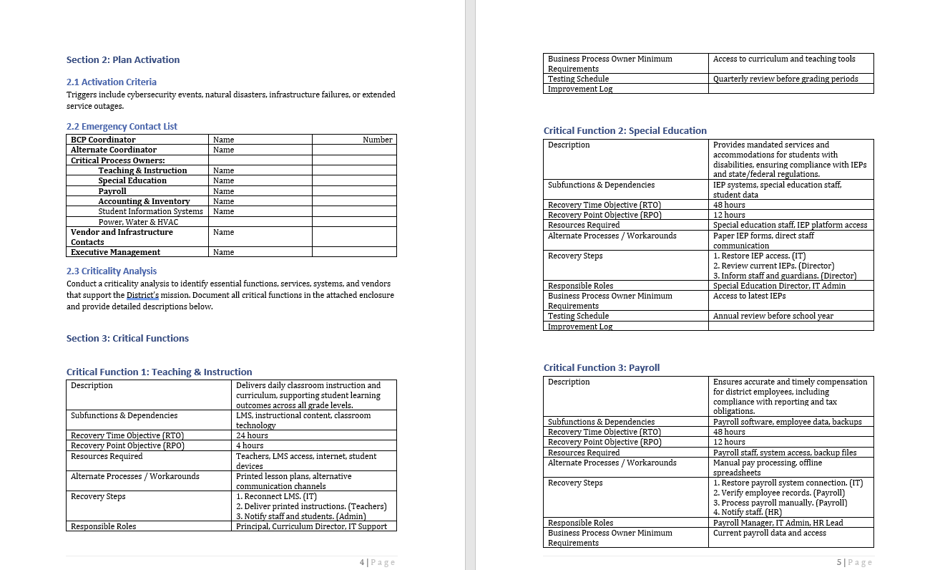
Part Three: Business Continuity and Incident Response Workshops
Engagement Expectations
Reviews Incident Response Planning and Business Continuity Planning steps and procedures
Provide templates for IR and BCP so you can adapt to your own organization, compliant with HB96 requirements.
IR Plan contains new OCIC Reporting requirements

Slide 13
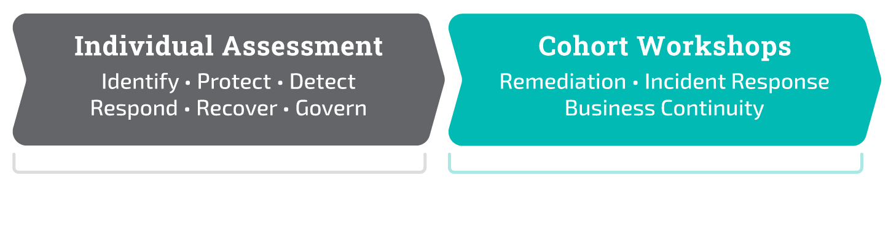
Timeline Overview
The full program is 10 months long, 60 minutes, every other week.
This prevents the security assessment from being disruptive to daily operations but sets a clear goal date.

Slide 14
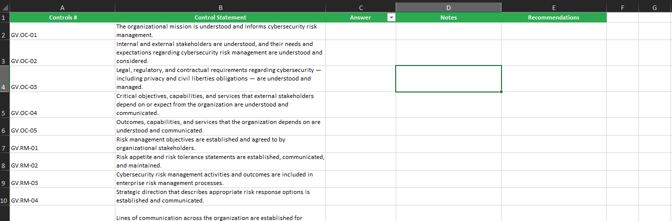
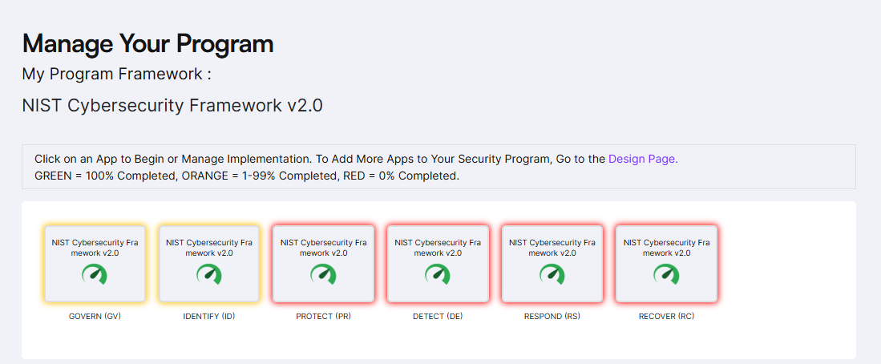
Governance, Risk, and Compliance Routines
School IT observes analyst fill in results during one-on-one assessment. 6 Months into program, establish GRC procedures to start doing it yourself.
  Excel provided with NIST CSF Controls, setup file storing routines for evidence and store narratives (left).
  Apptega (Assessment Tool) can be purchased via ITC. Results are pre-populated from your assessment. 5 Users, can manage tasks and assignments.

Slide 15
What Happens After the First Year?
The programs are designed to get you ready to manage your security program yourself. Some organizations request some additional assistance post assessment due to capacity.
vCISO/Fractional Analysts
Purchased in blocks of hours but billed as used.
Flexible usage for ongoing security tasks or as needed for unforeseen events.
Can include GRC Tool Management, Audit and Incident Response Support, and Reporting.

Slide 16
Contact Information
Art Provost
VP of Security Services
Email: artp@fes.org
Phone: 402.881.6369
Brendan Conway
Solutions Manager
Email: brendanc@fes.org
Phone: 402.432.2536
Visit filamentsecurity.org
to learn more.

